Slide 1


Guilherme Mene Ale Primo
10/02/2024

Slide 2

Outline
Executive Summary
Introduction
Methodology
Results
Conclusion
Appendix

Slide 3
Executive Summary
Summary of methodologies
Summary of all results

Slide 4
Introduction
Project background and context
The success and the cost reduction of the Falcon 9 from the SPACEX aims to the capacity of reusage of the first stage during launch. This can represent a reduction of ~100 million dollars for each launch to the aerial space program. To cover some technical aspects of that activity, this report summarize the prediction of the Falcon 9 first stage reusability. The results of that kind of the prediction can represent a significant cost reduction to the rocket company.
Problems you want to find answers
Can launch and landing data provide good information about future successful ground landing attempts?
What are the main conditions to predict the land of a launched rocket ?
What are the conditions which will provide a successful land and what are the relationship with the rocket effects and variables provided from past lands data?

Slide 5

Section 1

Slide 6
Methodology
Executive Summary
Data collection methodology:
Web scraping from Falcon 9 table (Wikipedia)
REST API (SpaceX)
Perform data wrangling
Handling the missing values
Remove unnecessary data from data frames
Encoding the categorical data
Perform exploratory data analysis (EDA) using visualization and SQL
Perform interactive visual analytics using Folium and Plotly Dash

Slide 7
Methodology
Executive Summary
Perform predictive analysis using classification models
The classification models were built using scikit-learn library
The tune process consisted of using GridSearchCV to parameterize the hyperparameters
The evaluation of the models were carried out using score and accuracy methods using the validation dataset

Slide 8
Data Collection
Describe how data sets were collected.
The REST API data were retrieved using the link api.spacexdata.com/v4/ and the process consisted of:
API request
Response (JSON)
Convert to dataframe
Pre processing data

Slide 9
Data Collection
Describe how data sets were collected.
The Webscrapping data were retrieved using the link https://en.wikipedia.org/w/index.php?title=List_of_Falcon_9_and_Falcon_Heavy_launches&oldid=1027686922 and the process consisted of:
Download whole HTML as text
Extract the html structure using BeaultifulSoap
Convert to dataframe
Pre processing data

Slide 10
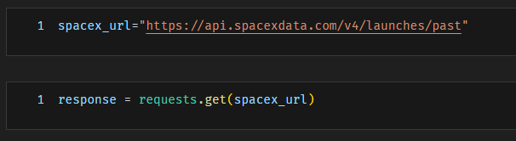
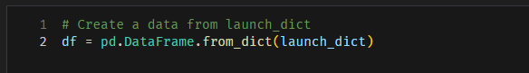
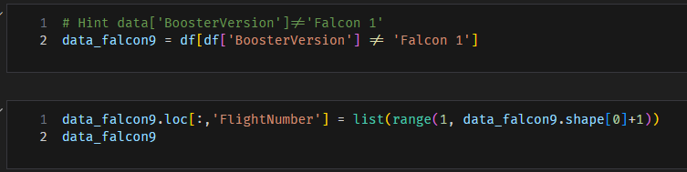
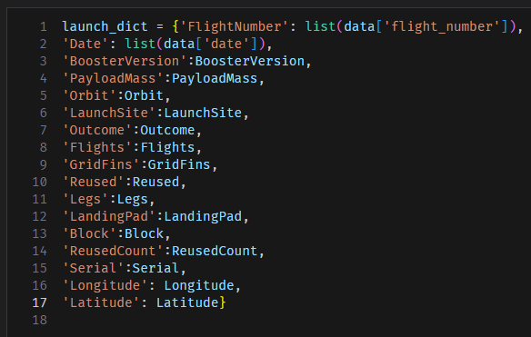
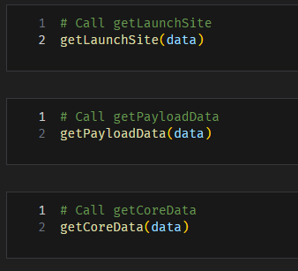
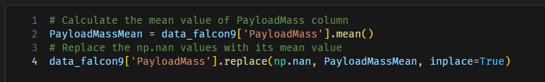
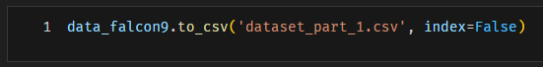
Data Collection – SpaceX API
Code
Make request
Convert dict to dataframe
Select specific data from dataframe
Convert response Json to dataframe
Transform data
Create dictionary of data
Handling missing values
Save the final file

Slide 11
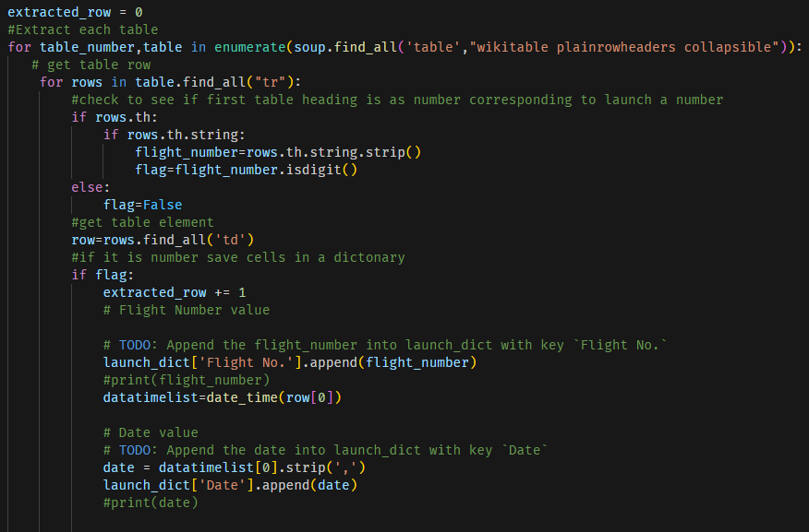
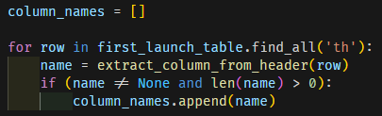
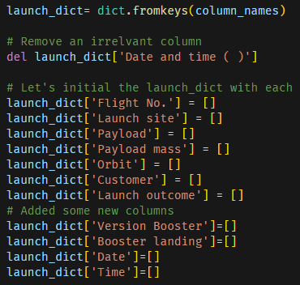
Data Collection - Scraping
Request HTML text
Code
Extract table
Convert to soup
Get column names
Create dictionary
Convert to dataframe
Save data

Slide 12
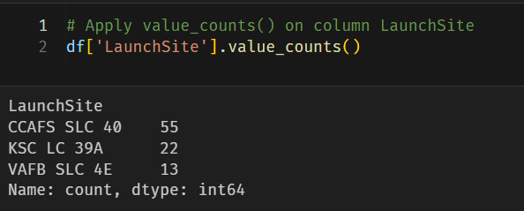
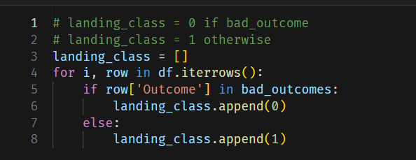
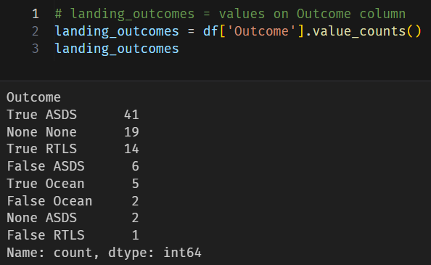
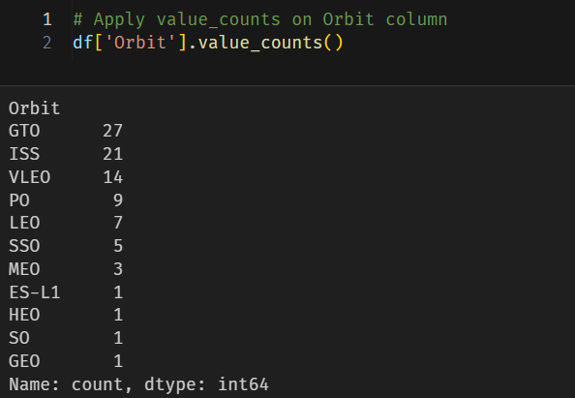
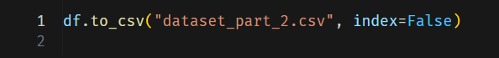
Data Wrangling
Code
There are several land types on dataframe representing the different land status, outcomes and sites.
According to the outcome of the land type, we need transform the categorical to numeric data and save the dataframe:
Launch Site count
Categorical to numeric transformation
Outcome count
Orbit type count
Save the file

Slide 13
EDA with Data Visualization
Code
To understand the data structure and the variables therein some plots were created to preview the database features:
Scatter Plots
Flight Number vs Payload Mass (using sns.catplot)
Flight Number vs Launch Site (using sns.catplot)
Payload vs Launch Site (using sns.scatterplot)
Flight Number vs Orbit (using sns.scatterplot)
Payload Mass vs Orbit (using sns.scatterplot)
Bar Graph
Showing the success rate of each orbit
Line Plot
Showing the success rate over the years

Slide 14
EDA with SQL
Code
The SQL queries were used to retrieve more information about the database and help to understand the data:
Display the names of the unique launch sites in the space mission
Display 5 records where launch sites begin with the string 'CCA'
Display the total payload mass carried by boosters launched by NASA (CRS)
Display average payload mass carried by booster version F9 v1.1
List the date when the first successful landing outcome in ground pad was achieved.
List the names of the boosters which have success in drone ship and have payload mass greater than 4000 but less than 6000
List the total number of successful and failure mission outcomes
List the names of the Booster Versions which have carried the maximum payload mass.

Slide 15
Build an Interactive Map with Folium
Code
Folium map was created with the NASA Johnson Space Center and the list below summarize the all task performed using the folium along the data:
Mark all launch sites on a map
Folium Circle and Markers with Launch Sites
Mark the success/failed launches for each site on the map
The success and failed launches were plotted using Folium Cluster Markers. The green was used for success and the red for failed launches.
Calculate the distances between a launch site to its proximities
The distance calculation using two coordinates points and plotting using Folium Polyline

Slide 16
Build a Dashboard with Plotly Dash
Code
The Dashboard have four main components:
The dropdown show the launch site options
The pie chart summarizes the success rate of each launch sites
The correlation between payload mass and success rate is demonstrated in the scatter plot with a range slider that’s provides the capability to select the payload mass range

Slide 17
Predictive Analysis (Classification)
Code
The prediction of the landing condition were separated on four steps:
Database load
Standard scale (data normalization)
Dataset splitting into training and validation
Data Preparation
Model Building
Evaluation
Model selection based on best accuracy
Setting classification estimators
Setting range of hyperparameters
Finding the best hyperparameters using GridSearchCV
Setting the best parameters to model
Get the accuracy for each model (training dataset)
Get the accuracy and score for each model (validation dataset)
Plot confusion matrix
Comparison of best model based on score
The best model

Slide 18
Results
Exploratory data analysis results
Interactive analytics demo in screenshots
Predictive analysis results

Slide 19

Section 2

Slide 20
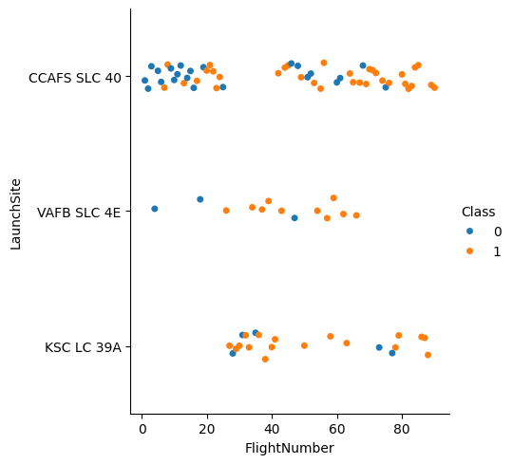
Flight Number vs. Launch Site
In recent flights the number of success rates has been increased, especially at the VAFB SLC 4E launch site.

Slide 21
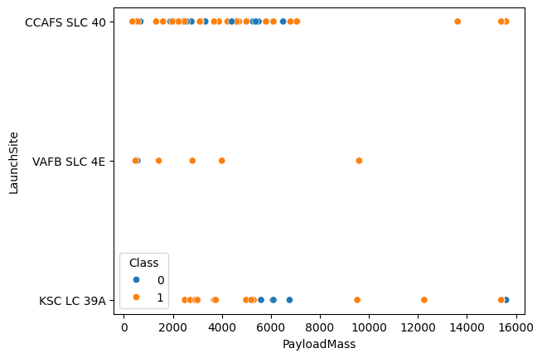
Payload vs. Launch Site
The CCAFS SLC 40 Launch Site show good successful rate with heavy payloads
The VAFB SLC 4E show good payload ranging between ~1000 to 10000 Kg with major successful rate
The KSC LC 39A varies on payload mass vs success rate

Slide 22
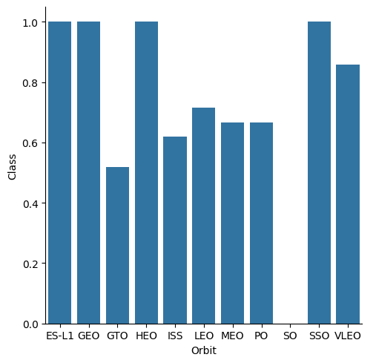
Success Rate vs. Orbit Type
The ES-L1, GEO, HEO, and SSO shows the most high success rate against the others orbits
The VLEO represent a success rate ~ 85%
The GTO, ISS, LEO, MEO, and PO exhibit the lower success rate, ranging from ~ 50 to 70 %

Slide 23
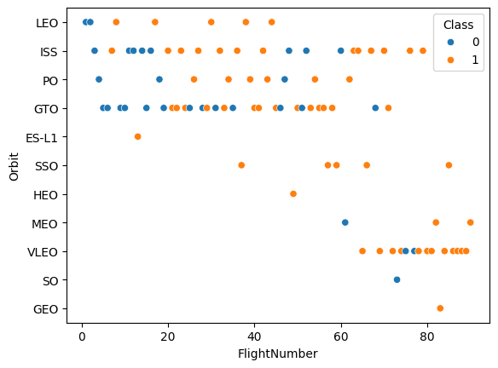
Flight Number vs. Orbit Type
The success rate were increased to almost orbit types except the GTO, VLEO, and SO.
A concern about SO and GEO is that there are too few samples for more accurate analysis

Slide 24
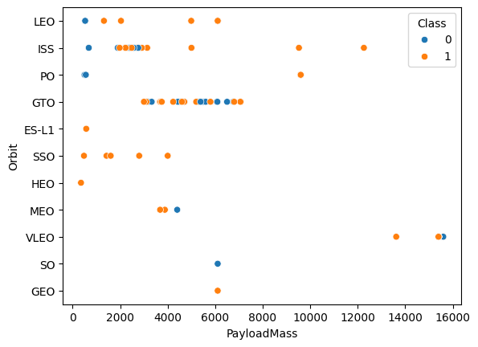
Payload vs. Orbit Type
The payload mass can drive to a success rate over orbit types. For example to the ISS and LEO, there are heavy payload with good rate of successful land

Slide 25
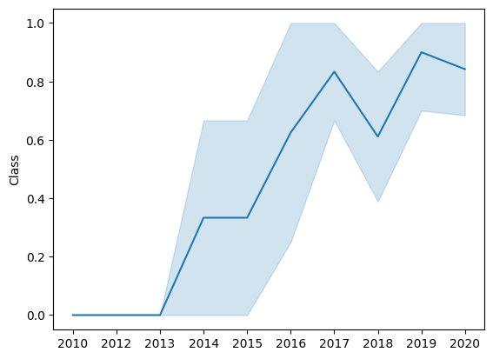
Launch Success Yearly Trend
The success rate from the SpaceX rockets were increased since 2013. However, a large increase in this success rate occurred by 2015, with two peaks in 2017 and 2019.

Slide 26
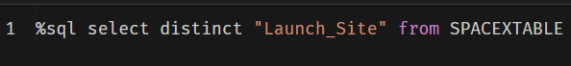
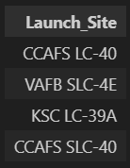
All Launch Site Names
SQL Query
Using select method to gather all unique values (distinct) from launch site column
Results

Slide 27
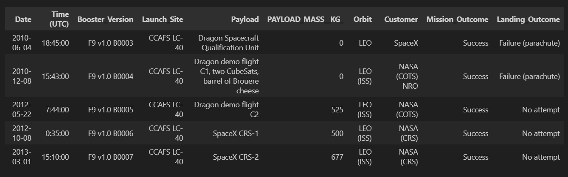
Launch Site Names Begin with 'CCA'
SQL Query
Results
Using select method to gather 5 rows (limit 5) where Launch Site ‘like’ CCA

Slide 28
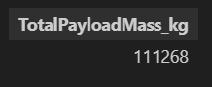
Total Payload Mass
SQL Query
Results
Return the sum of the Payload as TotalPayloadMass_kg
Using where Payload ‘like’ CRS

Slide 29
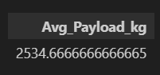
Average Payload Mass by F9 v1.1
SQL Query
Results
Return the average of Payload using Booster version ‘like’ F9 v1.1

Slide 30
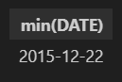
First Successful Ground Landing Date
SQL Query
Results
Return the minimum date for landing outcome with ‘success’ in the value of the cells

Slide 31
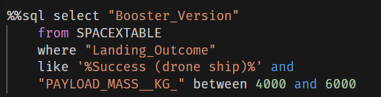
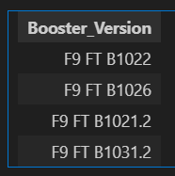
Successful Drone Ship Landing with Payload between 4000 and 6000
SQL Query
Return the Booster version
Using where landing outcome have ‘Success (drone ship)’ on the values and payload ranges from 4000 and 6000
Results

Slide 32
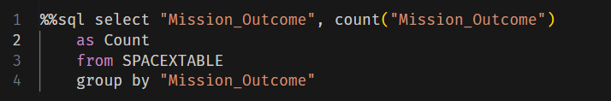
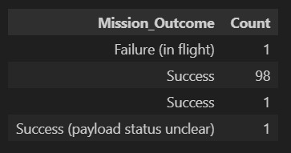
Total Number of Successful and Failure Mission Outcomes
SQL Query
Results
Return the Mission outcome with count of the mission outcome status grouping by mission outcome

Slide 33
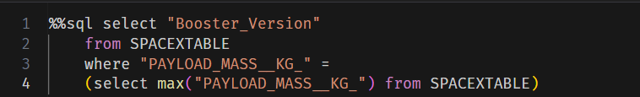
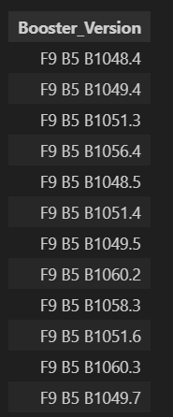
Boosters Carried Maximum Payload
SQL Query
Results
Return the boosters with maximum payload using sub query

Slide 34
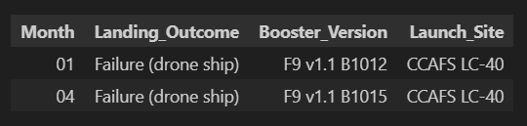
2015 Launch Records
SQL Query
Results
Return the records with their month, failure landing outcome, booster version and launch site for the launches from 2015

Slide 35
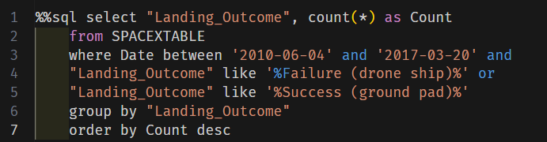
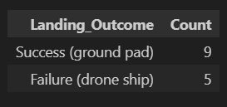
Rank Landing Outcomes Between 2010-06-04 and 2017-03-20
SQL Query
Return the count of the success (ground pad) and Failure (drone ship) records from DB
Results

Slide 36

Section 3

Slide 37
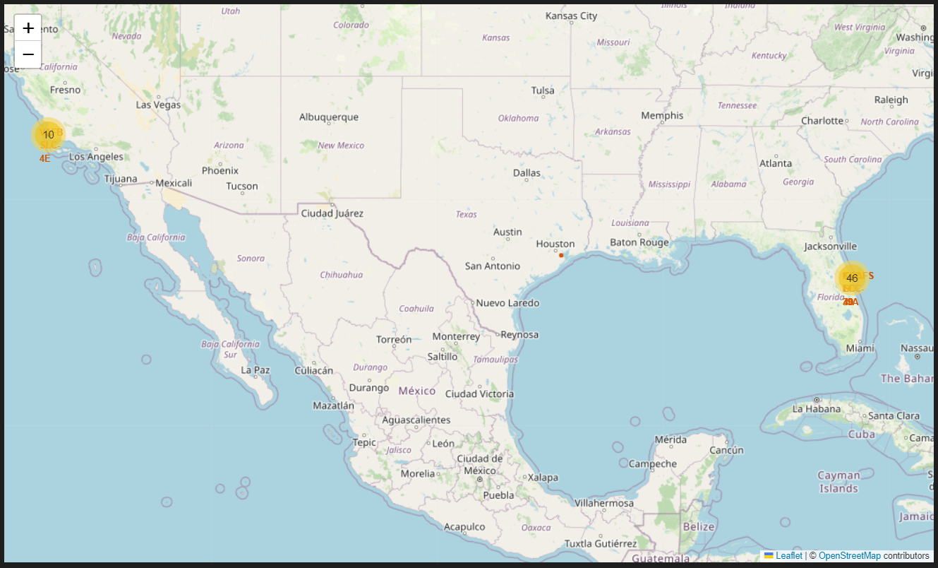
Folium Map Launch Sites
The main launch sites of the US are from coast lines of Miami and California

Slide 38
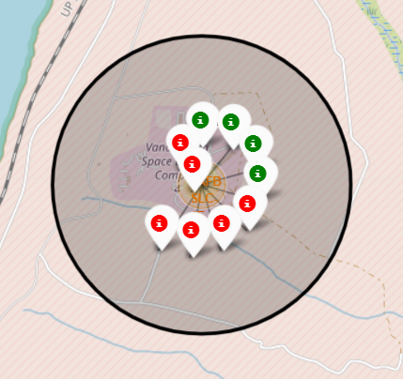
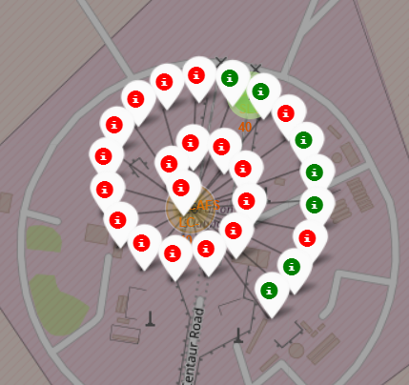
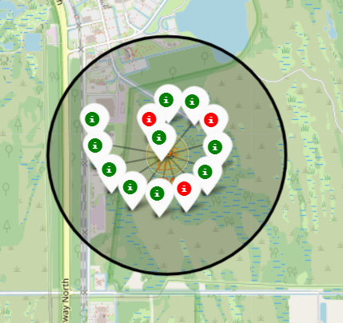
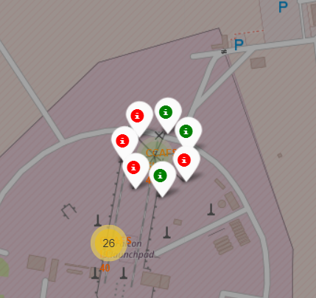
Folium Map – Success / Failed Launches
The Launch Site with higher success rate is KSC LC-39A

Slide 39
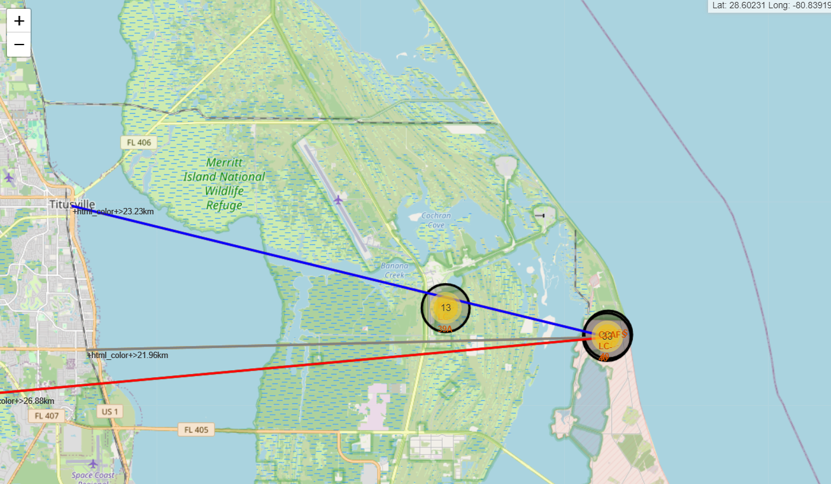
The Launch Sites facilities
The chosen launch site was the CCAFS SLC-40 that’s:
Almost 0.86 km from coast line
~ 22km from nearest railway
~ 23 km from nearest city, and
~ 27 km from nearest highway

Slide 40

Section 4

Slide 41
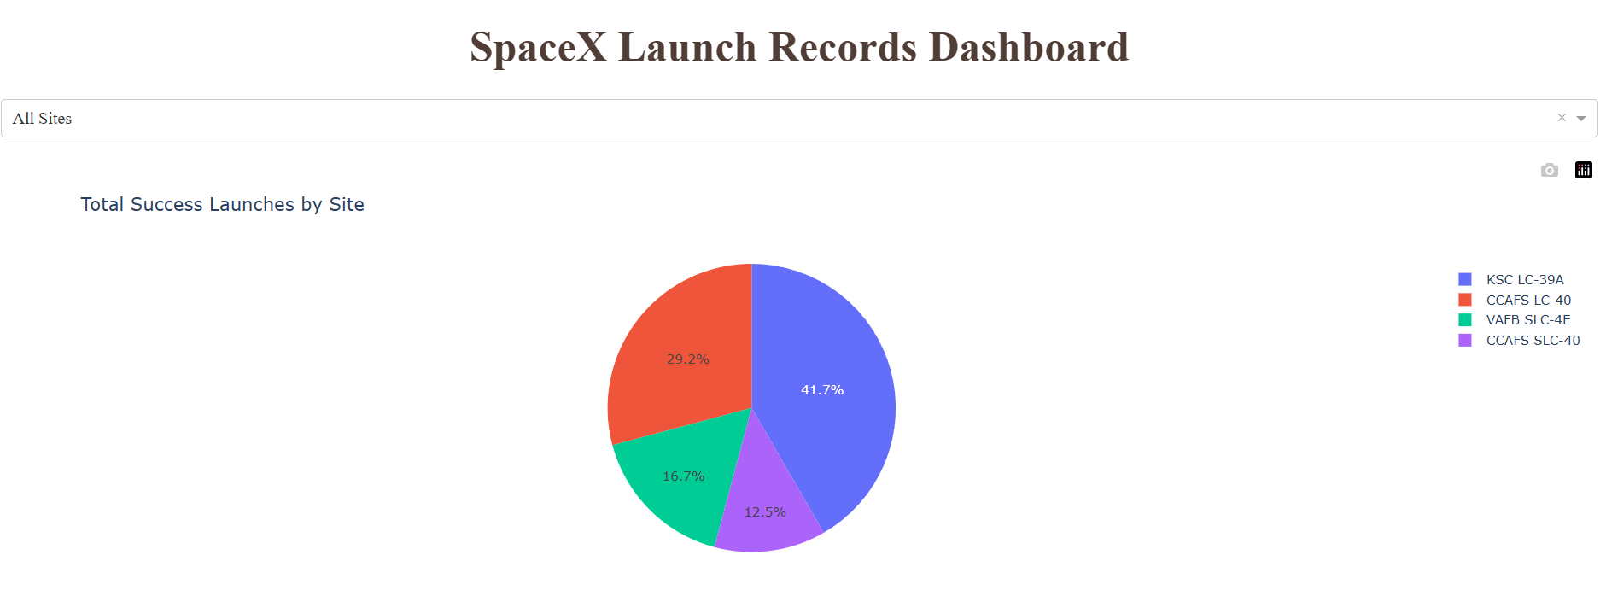
Successful rate by Launch Sites
Replace <Dashboard screenshot 1> title with an appropriate title
Show the screenshot of launch success count for all sites, in a piechart
Explain the important elements and findings on the screenshot
The best Launch Site was the KSC LC-39ª with 41.7%

Slide 42
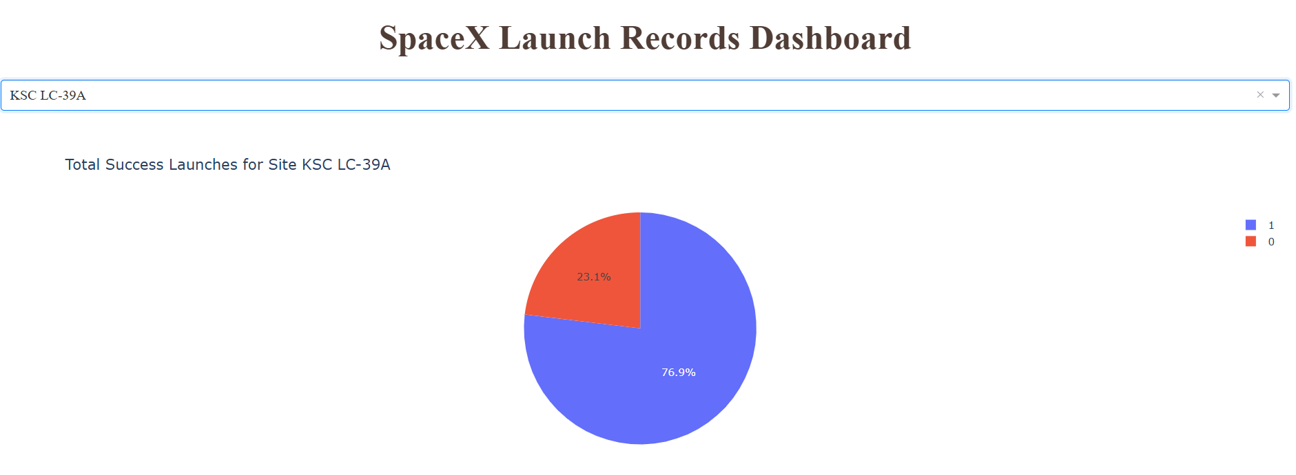
The KSC LC-39A Launch Site
The KSC LC-39ª shows 76.9% of success rate

Slide 43
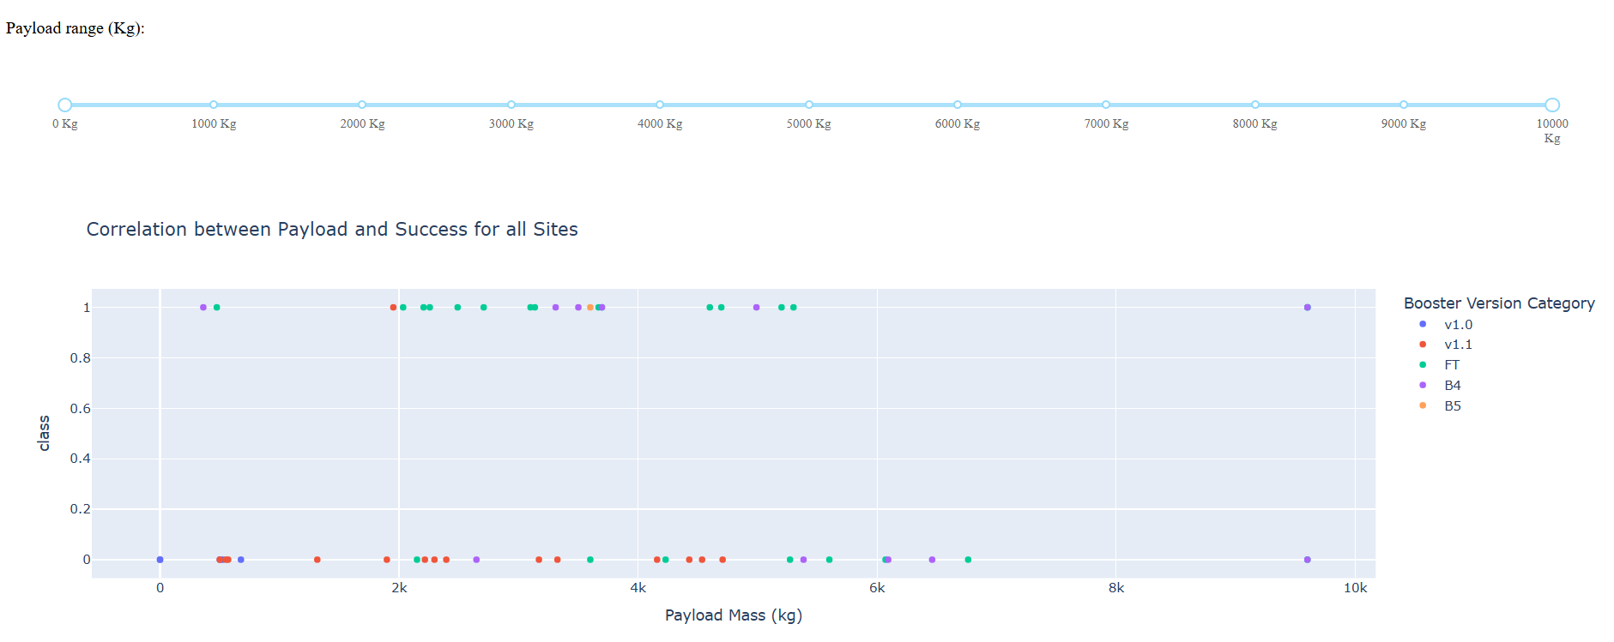
Correlation between Payload Mass vs Success Rate
The best range of payload for the success rate are from 2000 kg to ~ 5300 kg

Slide 44

Section 5

Slide 45
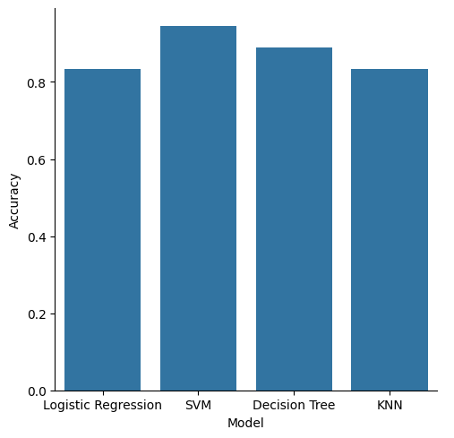
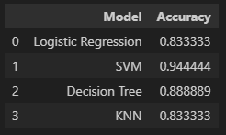
Classification Accuracy
The best model accuracy was calculated from the SVM model with 0.944 and the second high accuracy was from Decision Tree with 0.888

Slide 46

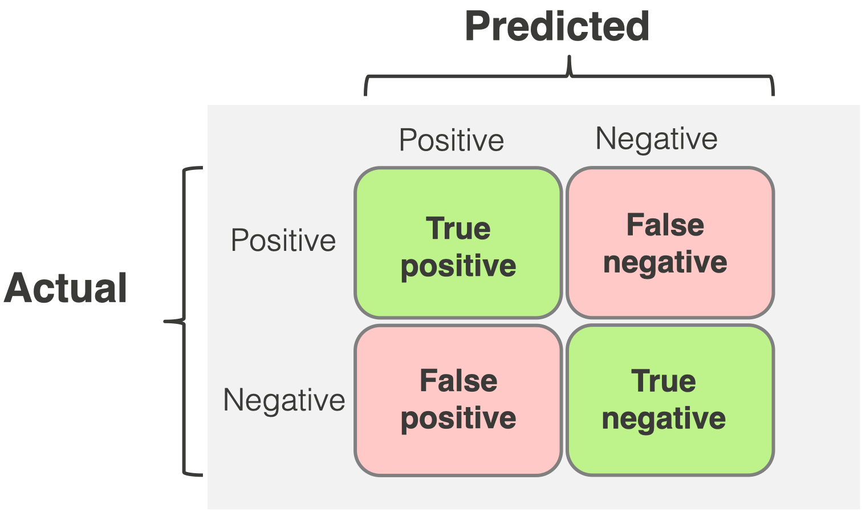
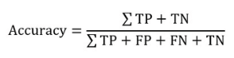
Confusion Matrix
The SVM model shows good accuracy when we visualize the confusion matrix. There is only 1 false negative prediction, while the true positive and negative measurements account for 17.
The accuracy is calculated using the true positive, true negative, false positive, and false negative from the model using the equation below:

Slide 47
Conclusions
The datasets provided a good structure for the Data Analysis of the SpaceX landing and launches
During the EDA process we can observe some bullet points:
The success rate increase over time
Payload Mass can infer the success rate of the launch mission
The ES-L1, GEO, HEO, and SSO shows the most high success rate against the others orbits
The success rate increased considerably in 2013, followed by 2017 and 2019
The KSC LC-39A showed the best launch site rate
Launch missions take place in the southern part of the USA, due to its proximity to the equator.
The classification models performed similarly, with SVM showing the best accuracy amongst others

Slide 48


